Slide 1
ITE401 COMPUTER GRAPHICS AND MULTIMEDIA

Slide 2
Name : Nancy Victor
Designation : Assistant Professor
Email : nancyvictor@vit.ac.in
Cabin : SJT 213 A16
Open Hours : Wednesday [9.00 -9.50 AM]
Friday [10.30- 11.30 AM]
Contact No : 9487836200 [ only 9.00 AM -5.00 PM]
Experience : 2 years in VIT + 2 Years

Slide 3
SYLLABUS

Slide 4
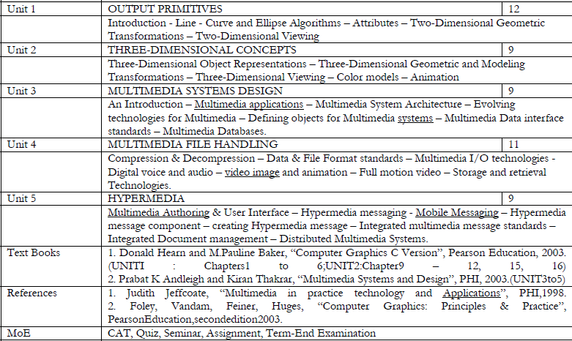

Slide 5
ASSESSMENT
Component | Max Marks | % weightage
MID TERM EXAM | 50 | 20
PROJECT | 20 | 20
ASSIGNMENT / SEMINAR | 10 | 10
TERM END EXAM | 100 | 50

Slide 6
IMPORTANT DATES
PBL Group Formation ( 3 Members) | 20th July
Project Title | 30th July
Review 1 | 16th - 23rd August
Mid-Term Exam | 3rd – 11th October 2015
Review 2 | 12th – 16th October
Final Review | 2nd – 6th November 2015
TEE Exam | 16th November – 3rd December 2015

Slide 7
Thank You…

